Slide 1
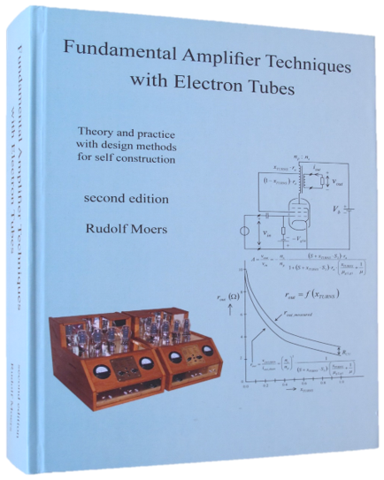
An investigation of the screen grid tap
A search for the hidden arguments
by Rudolf Moers
ETF2022
Baarlo
The Netherlands

Slide 2
This lecture is a follow-up of :
The Ultra Linear Power Amplifier
An adventure between triode and pentode
by Rudolf Moers
ETF2010
Stella Plage
France

Slide 3
Contents of this lecture:
Introduction
Definitions of the screen grid tap
The AC method for optimum UL according to Rudolf Moers
The DC method for optimum UL according to Ronald Dekker
The relationship between the AC-method and the DC-method
The µTracer of Ronald Dekker in a nutshell
THD-measurement results from the past
More recent THD-measurement results
Some interim conclusions
An intermezzo: static transconductance versus dynamic transconductance
Focus not only on anode characteristic but also on transconductance characteristic
The forgotten anode dynamic transconductances
Final conclusion

Slide 4
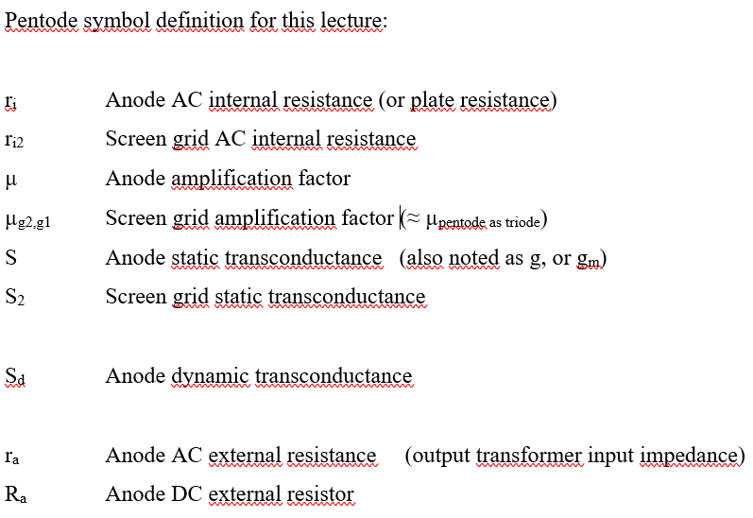
1. Introduction

Slide 5
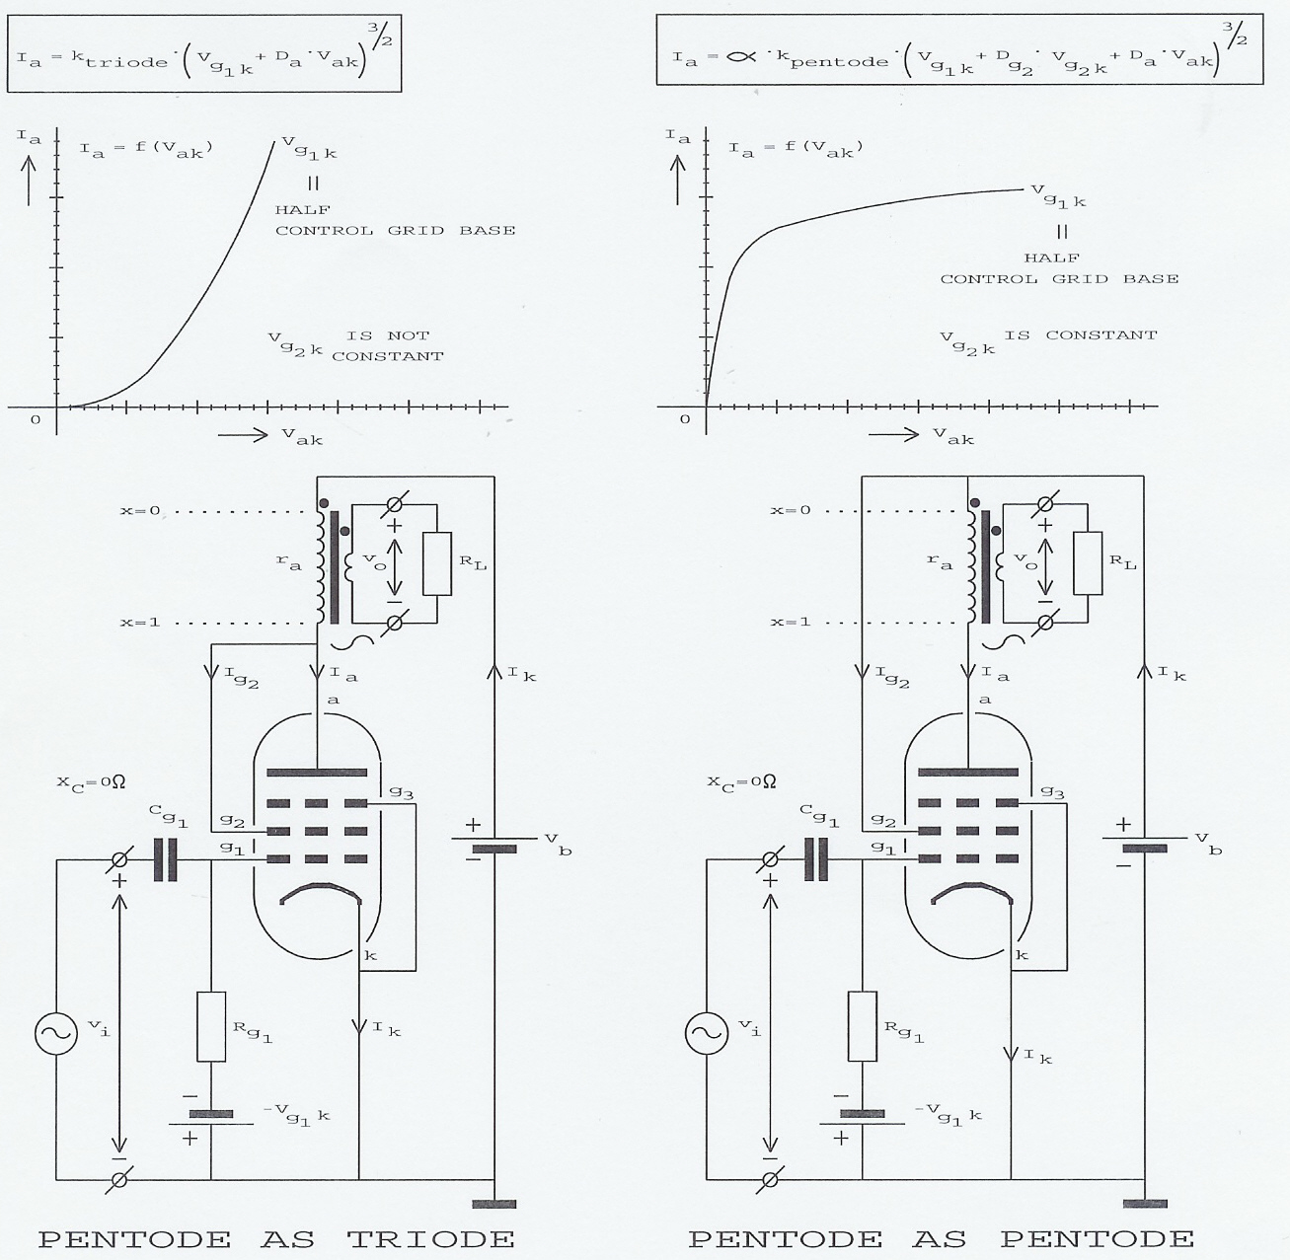
David Hafler & Herbert Keroes
(not the inventors) published
their Ultra Linear story in 1951.
Ultra Linear is a marketing name for:
Screen Grid Negative Feedback
Another name from the past is:
Distributed Load

Slide 6
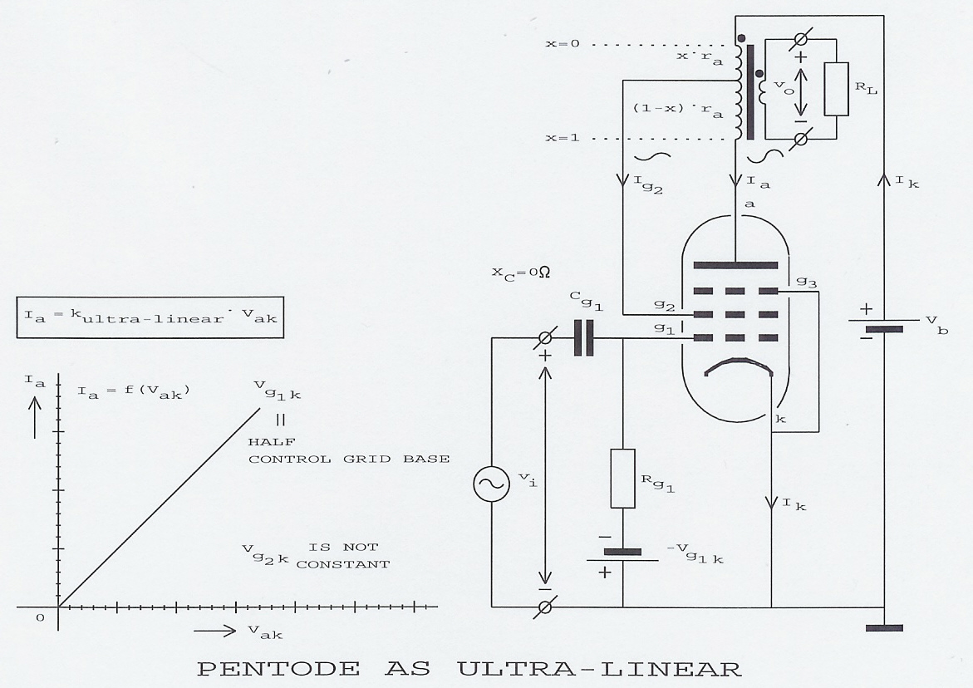
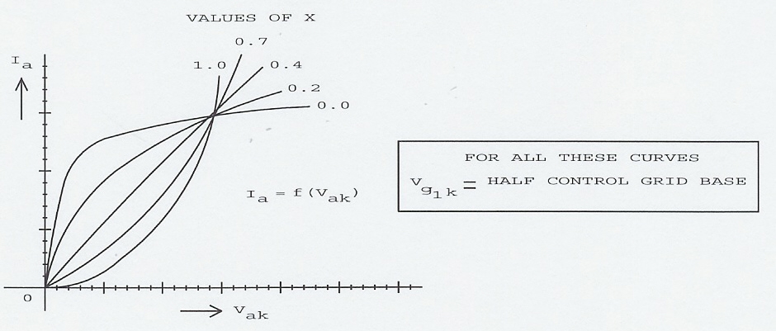
Screen grid tap of the primary transformer winding : x
Why ${ x = x}_{turns}$ will be explaned later
$$x_{turns}≈\frac{v_{g2k}}{v_{ak}}$$
$$x_{turns}=\frac{v_{g2k}}{v_{ak}}$$
In case i_{g2} << i_{a} :
And 0.0 ≤ $x_{turns}$ ≤ 1.0
$x_{turns}$ = 0.0 : penthode
0.0 < $x_{turns}$ < 1.0 : ultra-linear
$x_{turns}$ = 1.0 : triode

Slide 7
2. Definitions of the screen grid tap
The transformation ratio is the fraction of the primary voltage and the secondary voltage:
The transformation ratio is the fraction of the secondary current and the primary current:
The fraction of the transformation impedances:
hence
Now I give these fractions their own transformation ratio:
and
Hence
Screen grid tap x is a part of n (meant is here number of windings) and 0.0 < x < 1.0 hence
The next step is rather strange but I do this because x is a part of
and a part of :
.

Slide 8
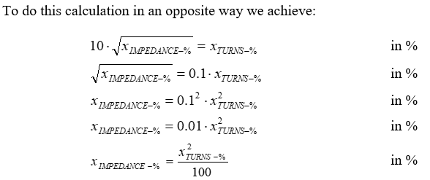

Slide 9
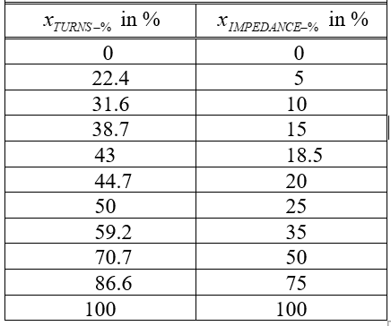
So we achieved :
$$x_{TURNS−\%}=10⋅\sqrt{x_{IMPEDANCE−\%}}$$
in % and
in %
When Hafler and Keroes determined that gives the lowest THD, then for those who “think in
screen grid tap in turns”, the lowest THD is at
$$x_{impedance−\%}=\frac{x_{turns−\%}^{2}}{100}= \frac{{43}^{2}}{100}=\frac{1850}{100} =18,5\%$$
And in the opposite way :

Slide 10
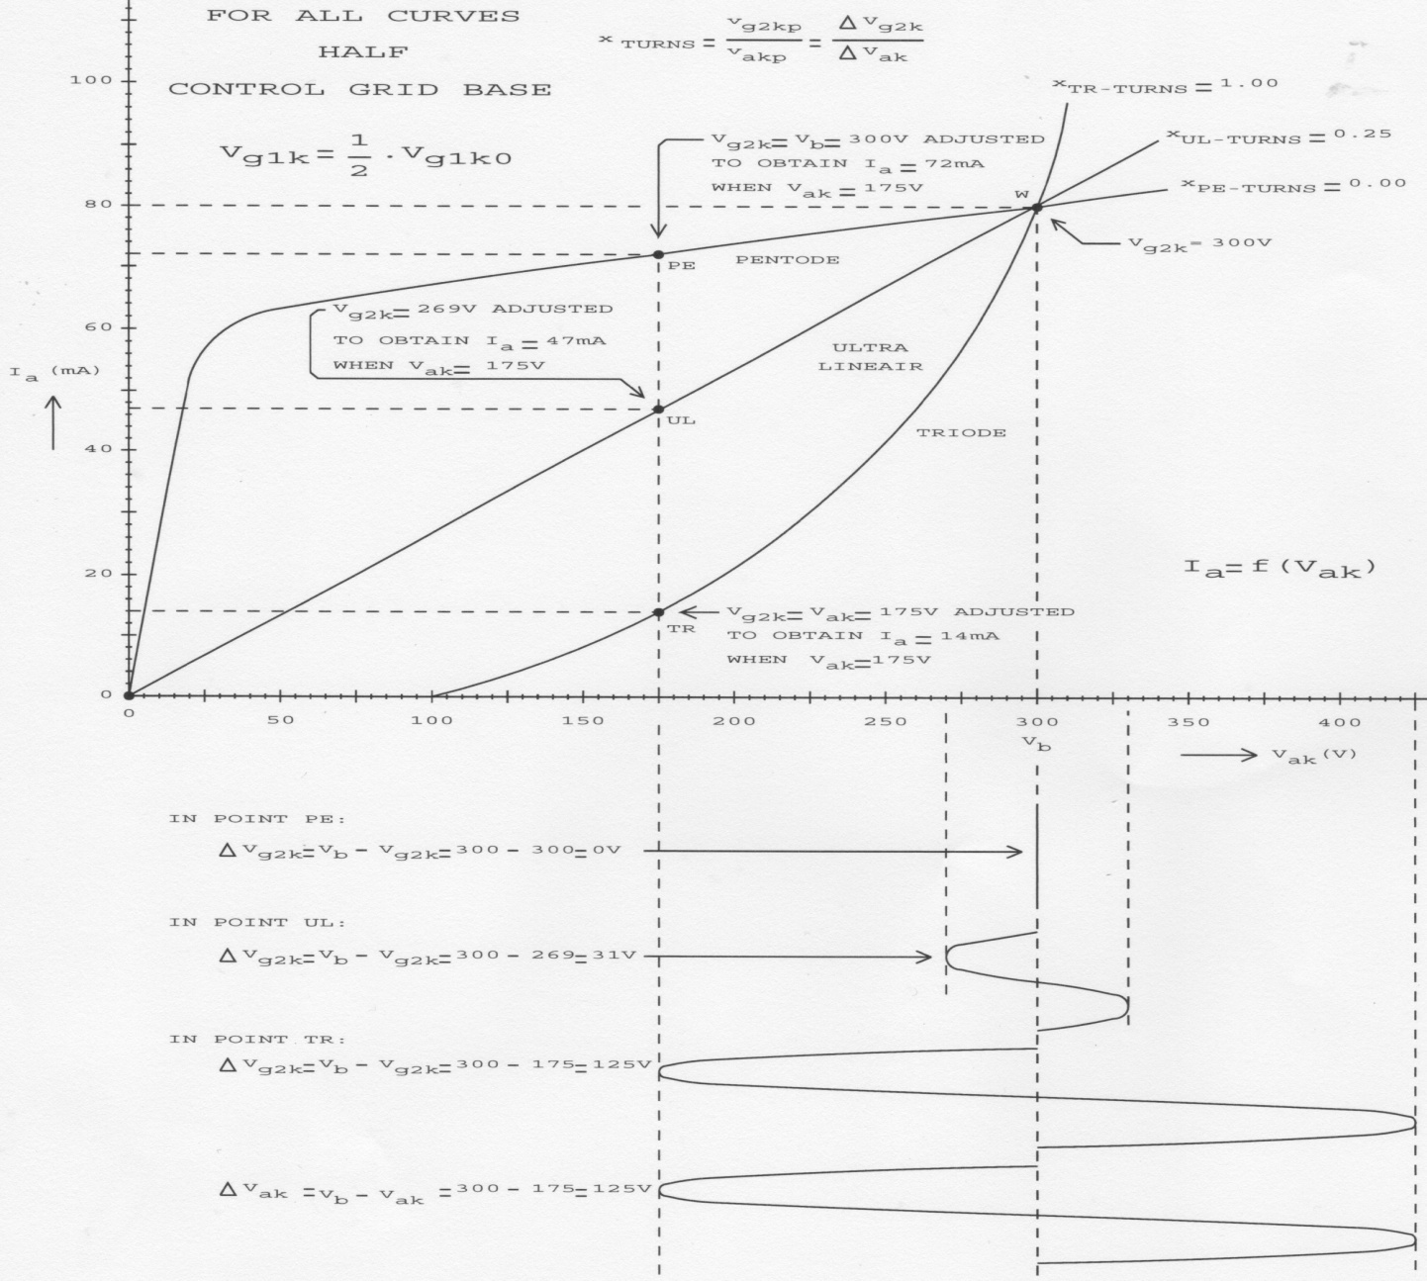
3. The AC method for optimum UL

Slide 11
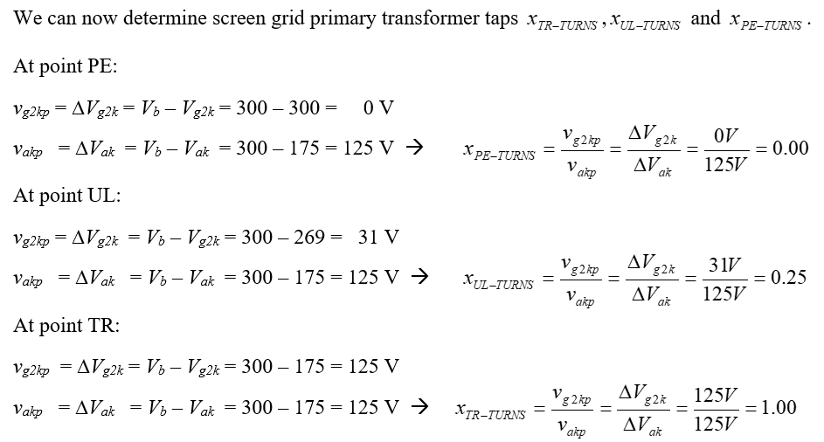

Slide 12
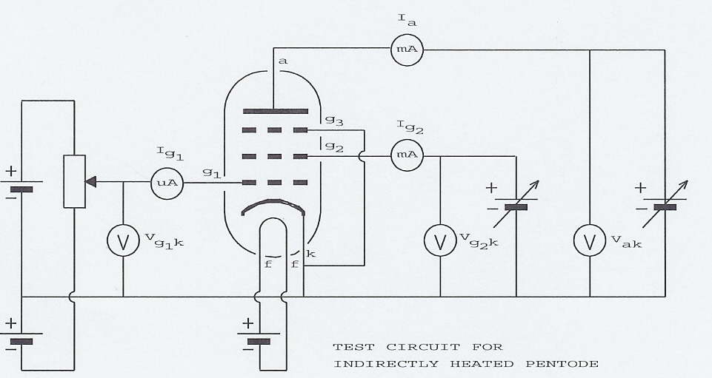
Test circuit for measuring of all static pentode characteristics.

Slide 13
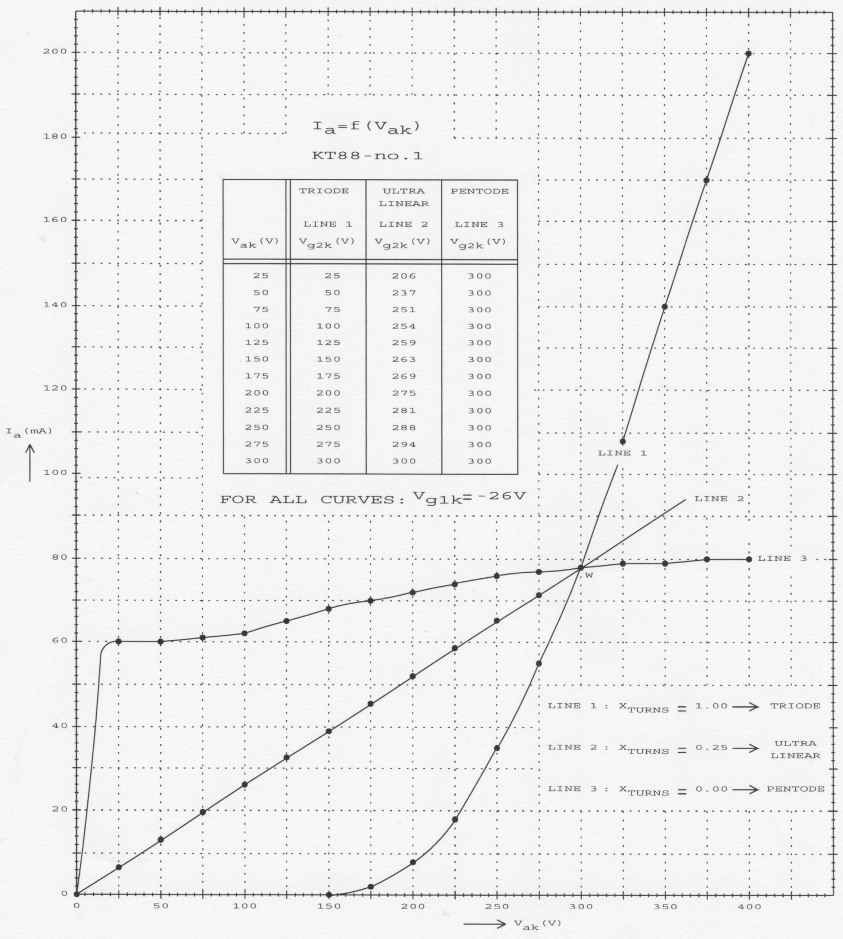

Slide 14
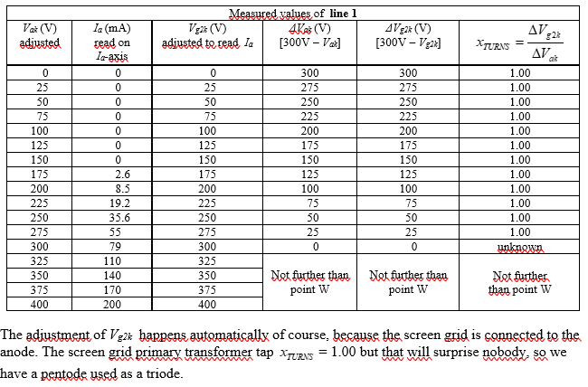

Slide 15
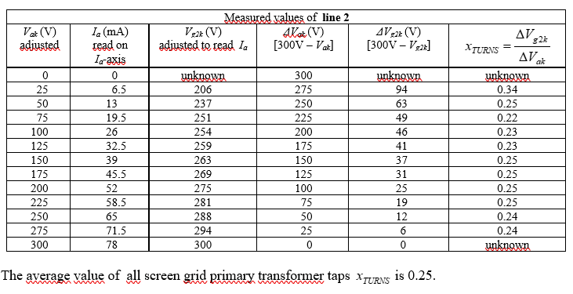

Slide 16
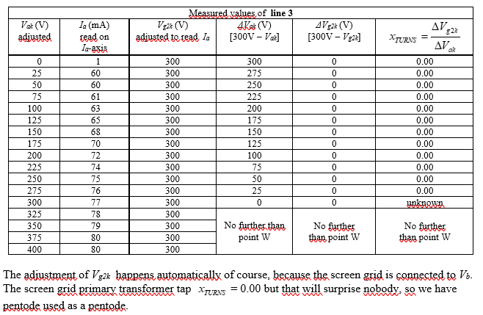

Slide 17
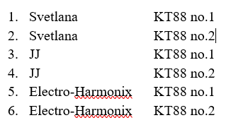
I have repeated this excersise 6 times with:
And 6 times with and never
$$x_{turns}≈25 \%$$
$$x_{turns}≈40 \%$$
Known is that the lowest THD is achieved at so what do I wrong ?
$$x_{turns}≈40 \%$$
Let’s see what the opinion is of Ronald Dekker, the DC-methode.

Slide 18
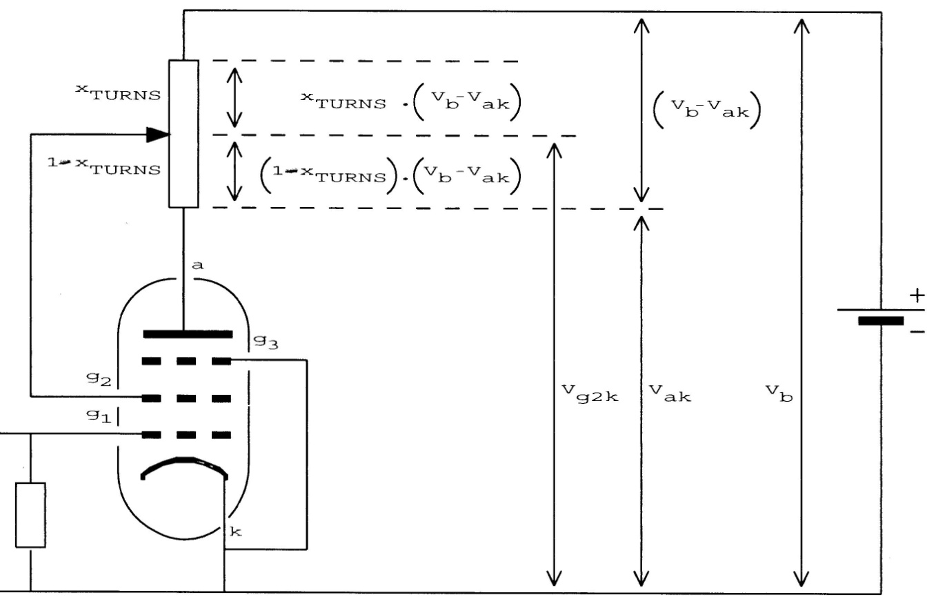
4. The DC method for optimum UL
Formula of Ronald Dekker :
http://www.dos4ever.com/uTracer3/uTracer3_pag0.html
Translated into my notation :

Slide 19
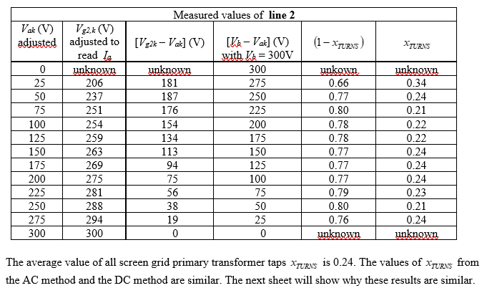

Slide 20
5. The relationship between the AC-method and the DC-method

Slide 21
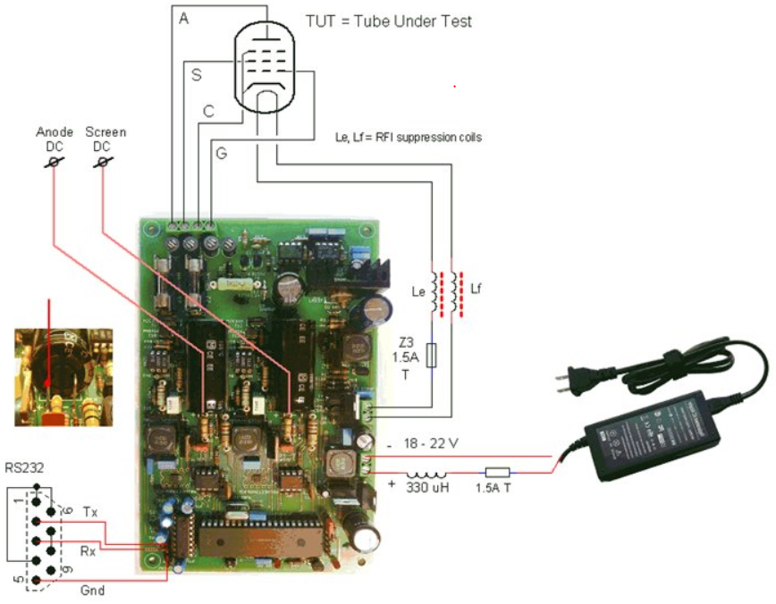
6. The µTracer of Ronald Dekker in a nutshell
Advice, visit this site
http://www.dos4ever.com/uTracer3/uTracer3_pag0.html
Advice, visit this site
The uTracer V6 (dos4ever.com)
Use RS232 to USB
convertor cable to
laptop or computer

Slide 22
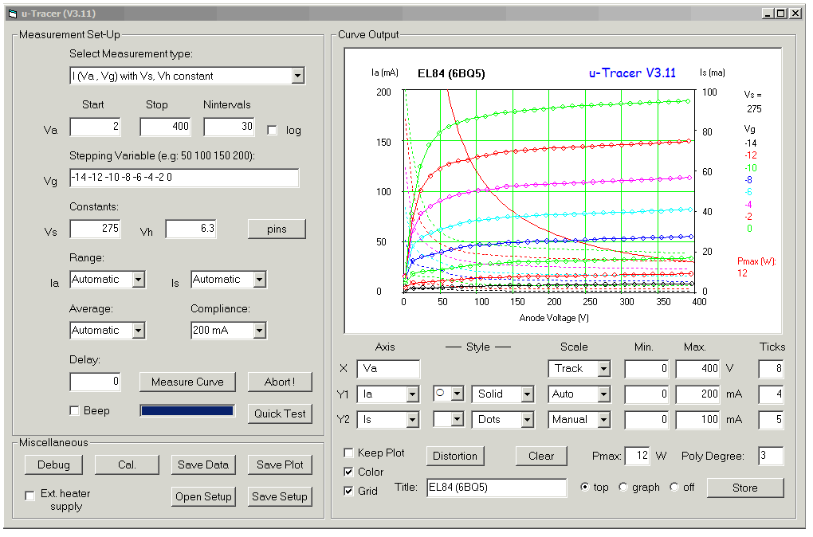
Graphical User Interface (GUI) running under Windows. With the GUI it is possible to set-up a measurement, and to display and manipulate the measurement data so that it is represented in exactly the same sets of curves as in the datasheets.

Slide 23
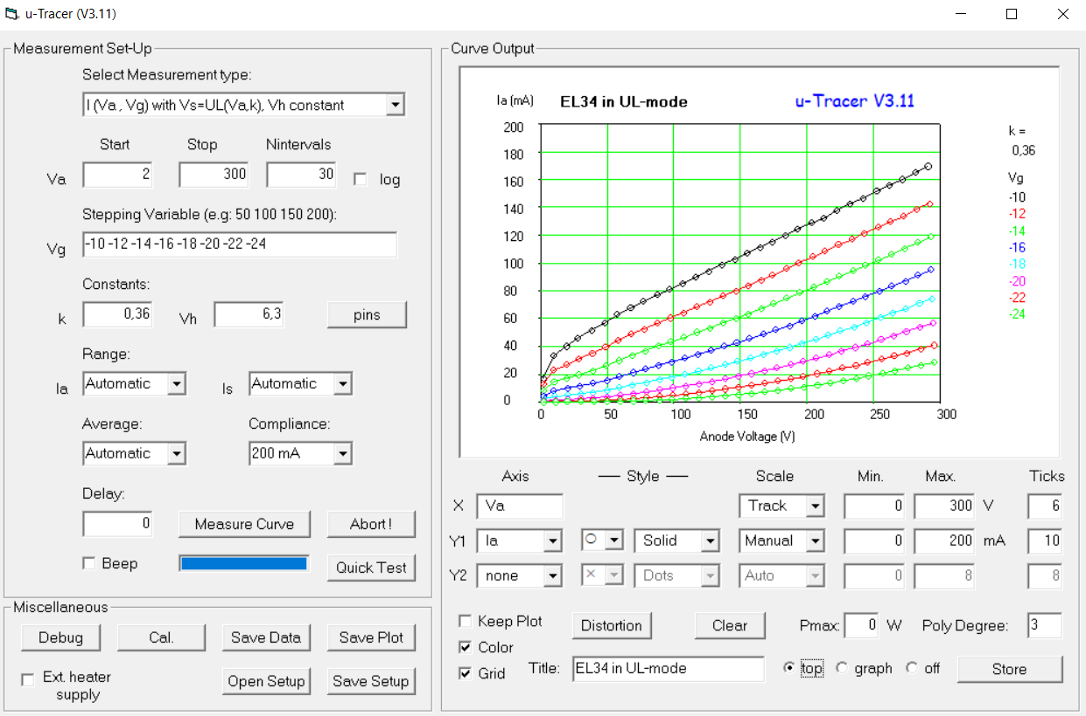
Example of measuring a EL34 in UL-mode with x_turns = k = 0.36

Slide 24
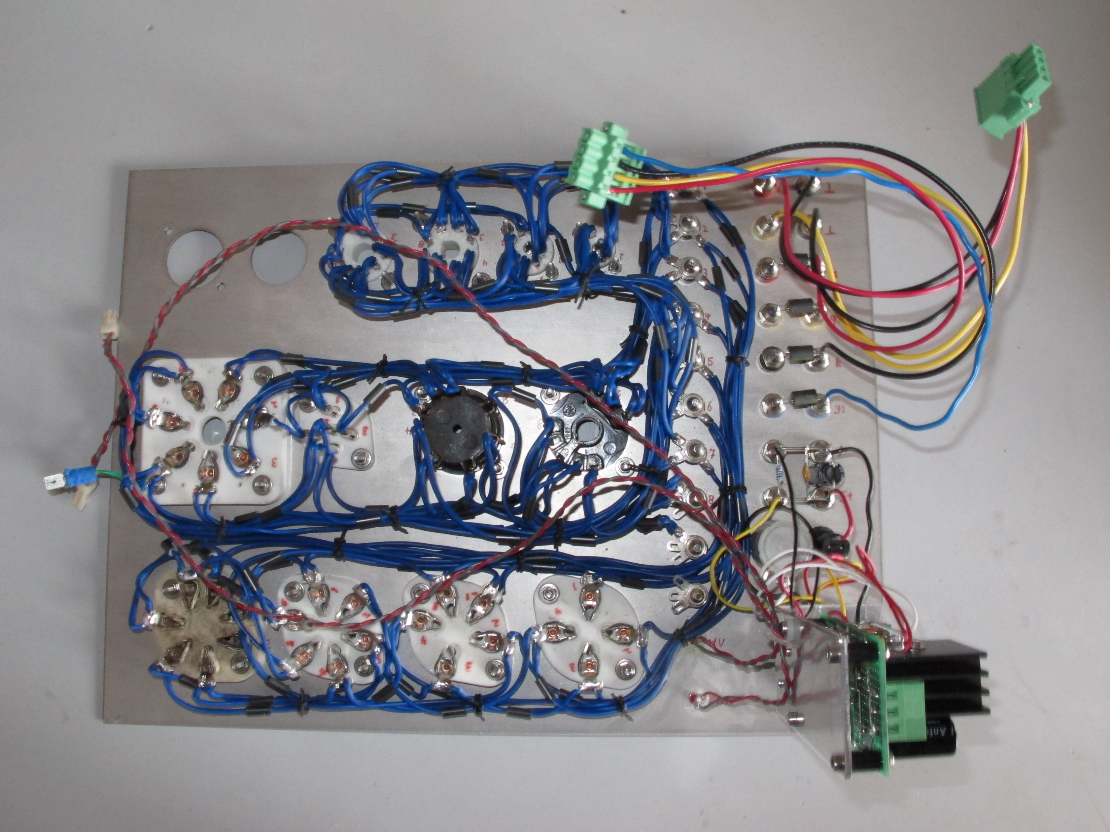
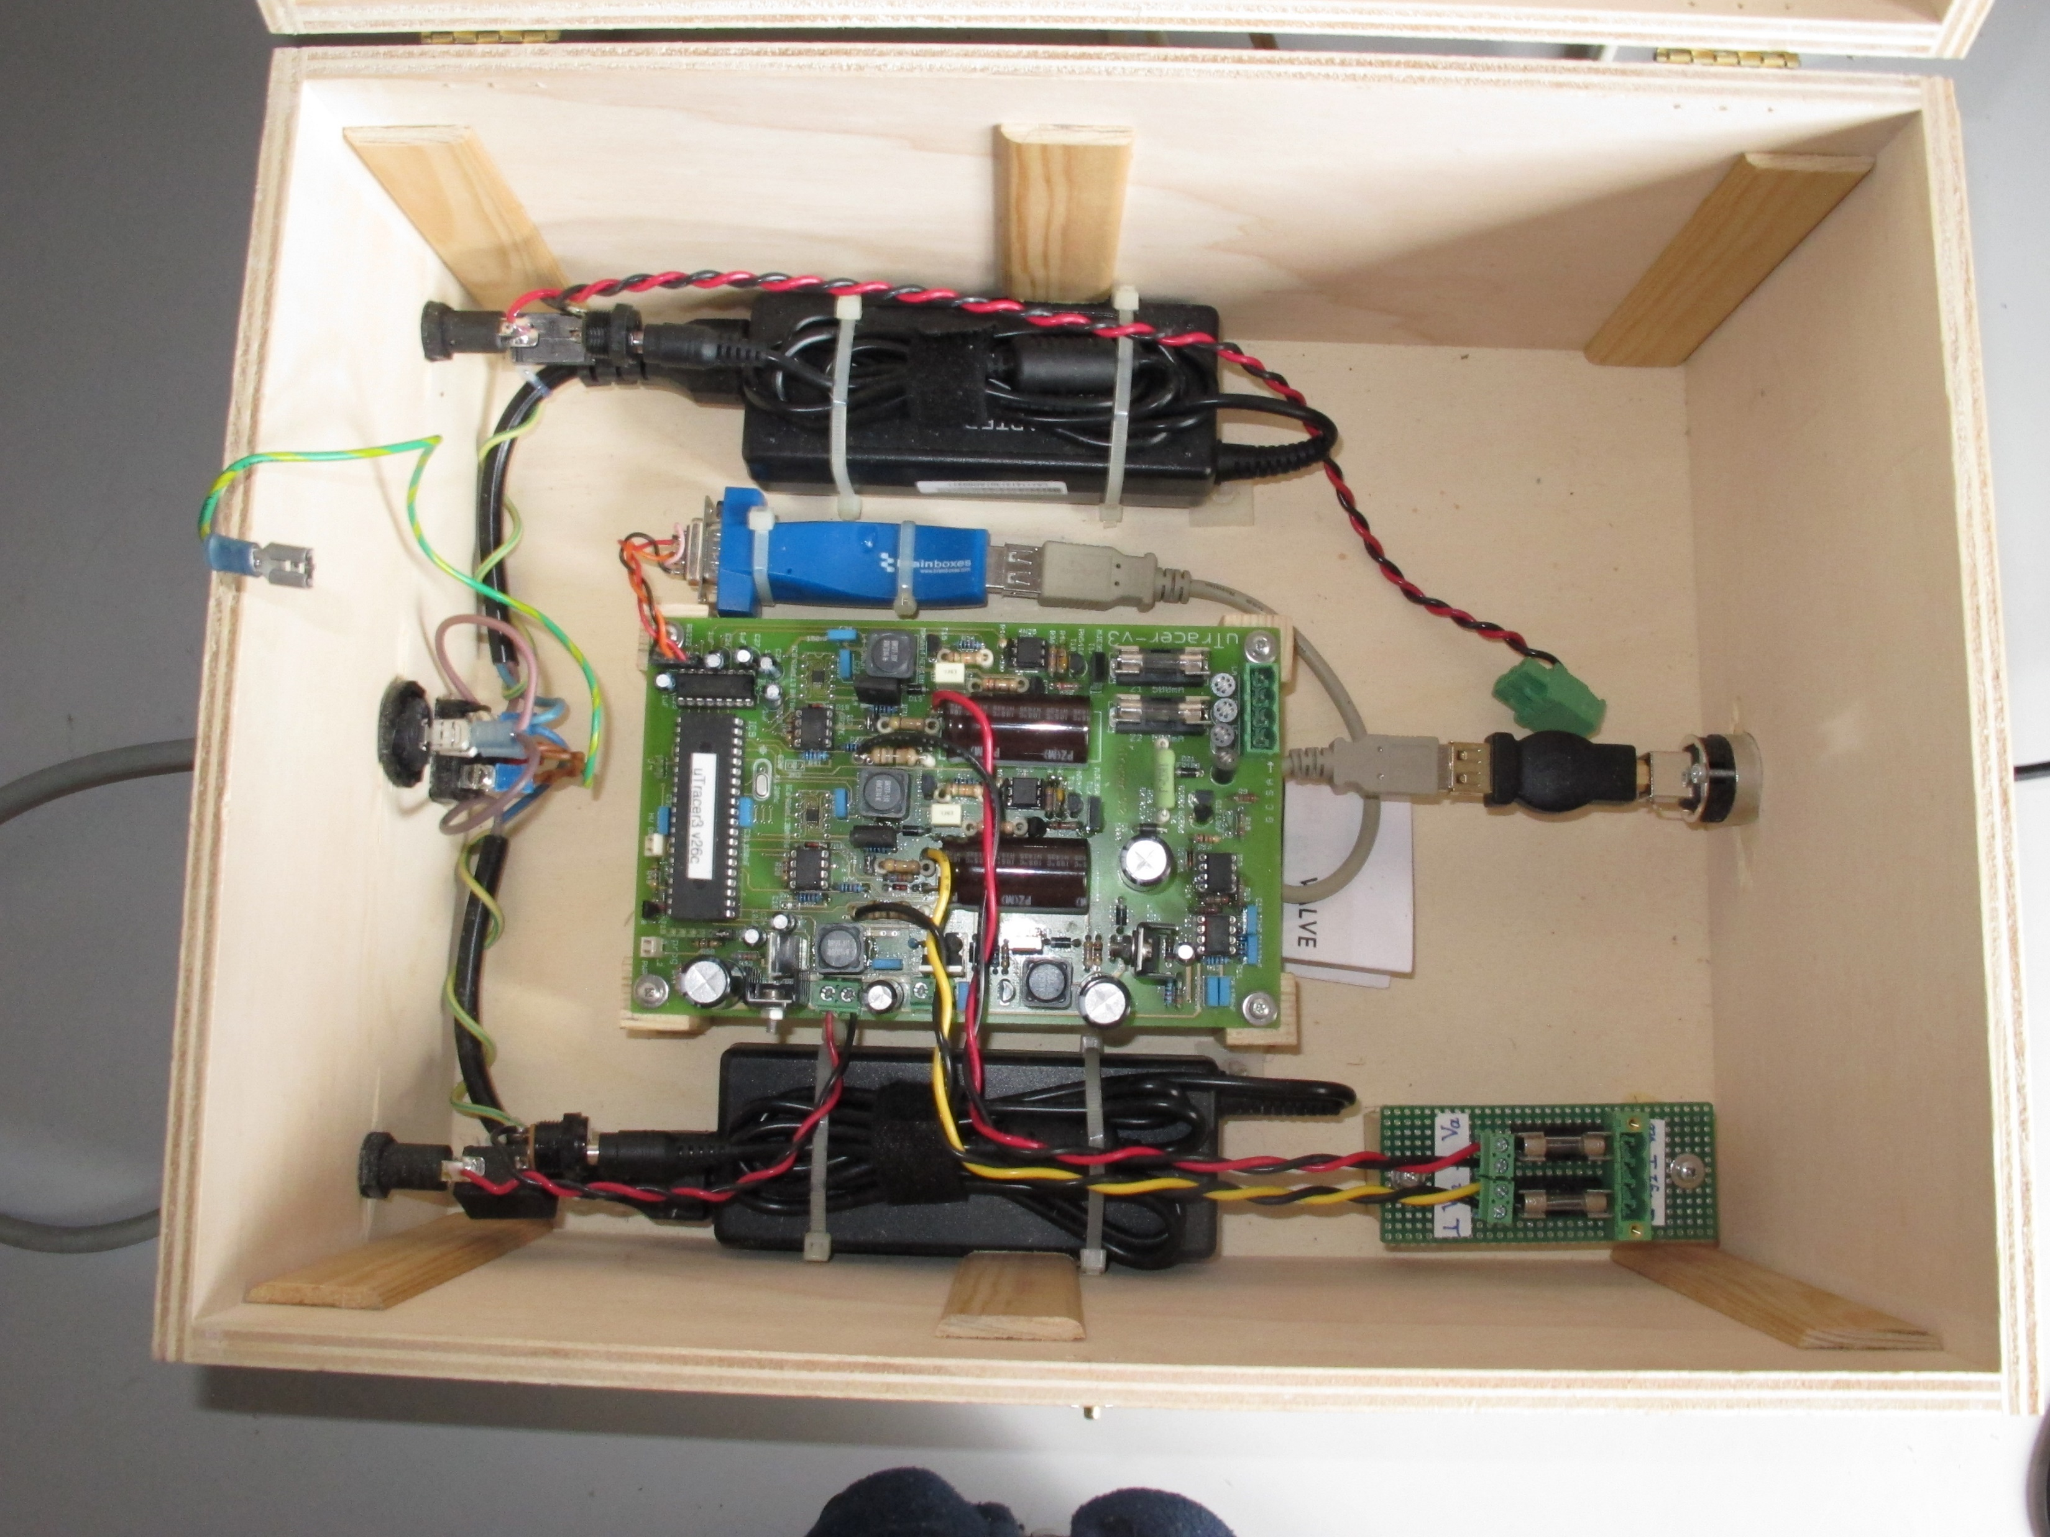
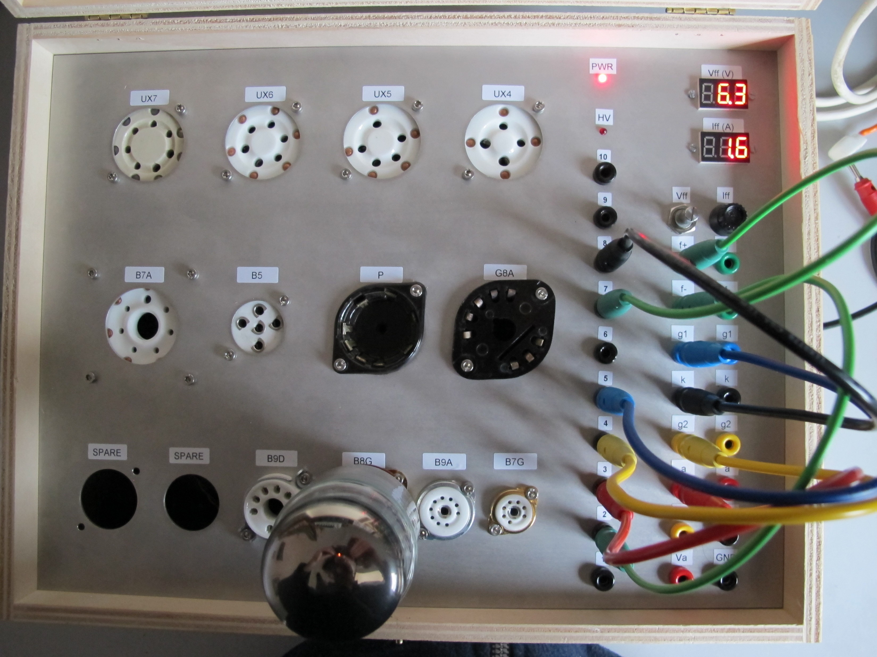
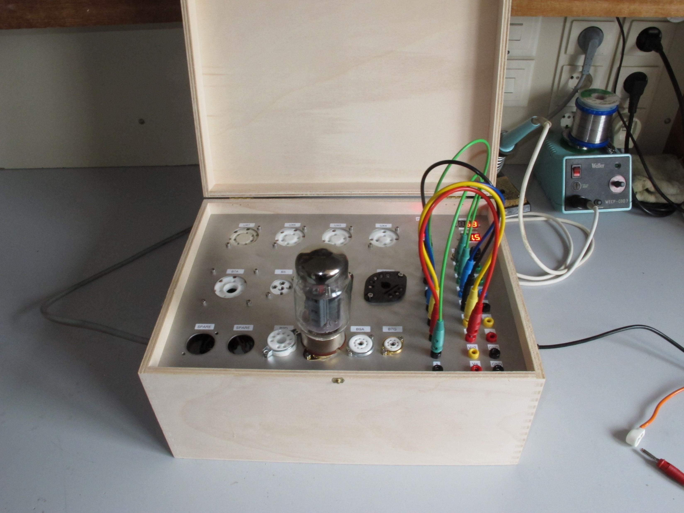
my µTracer
operates very
well

Slide 25
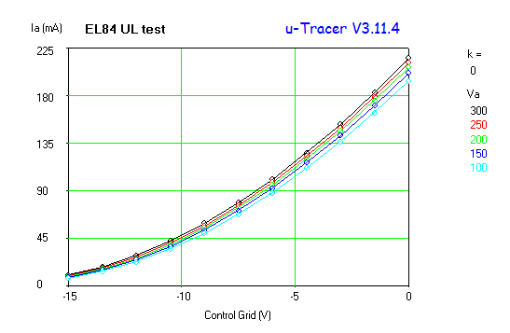
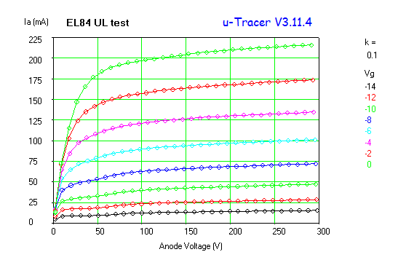
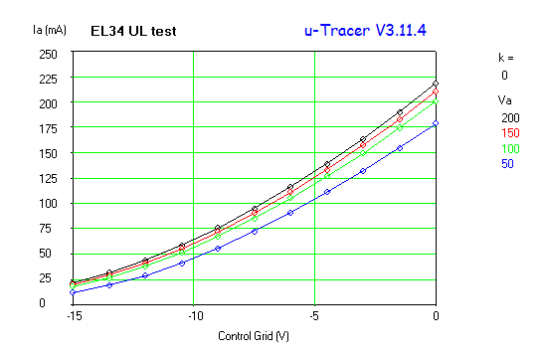
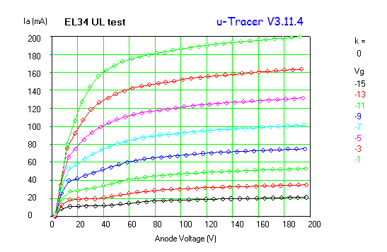
UL animation pictures made by Ronald Dekker
EL84
EL34

Slide 26
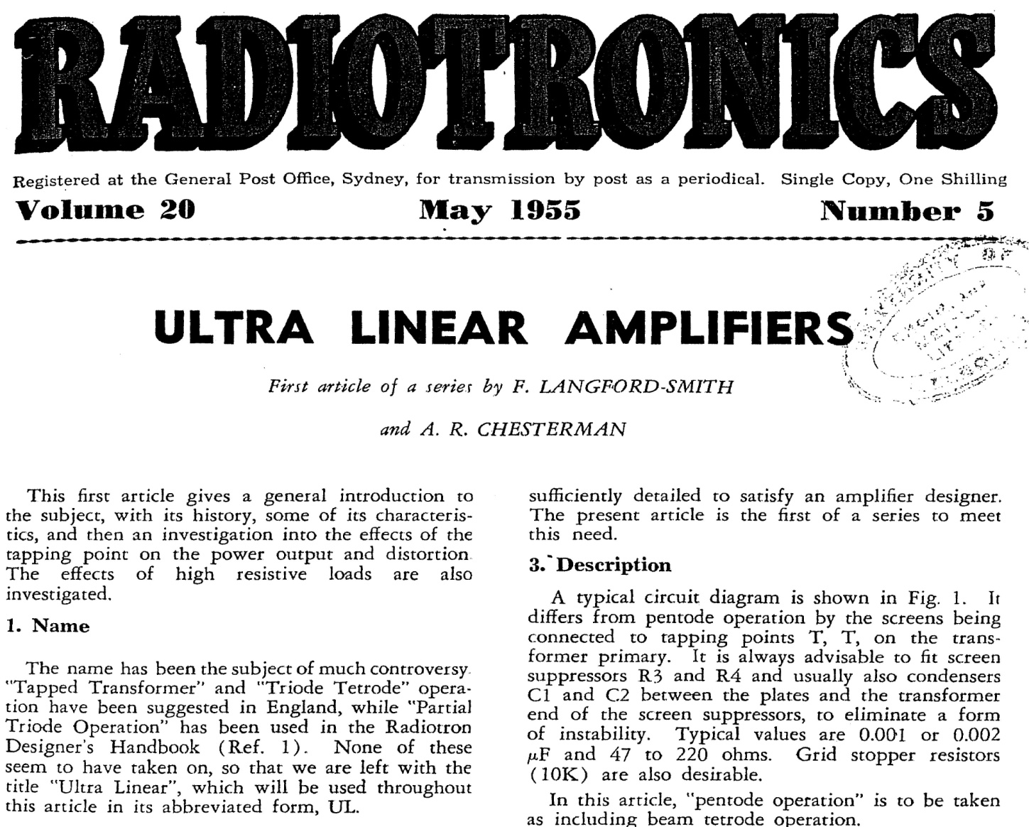
7. THD-measurement results from the past
← 14 May 1955

Slide 27
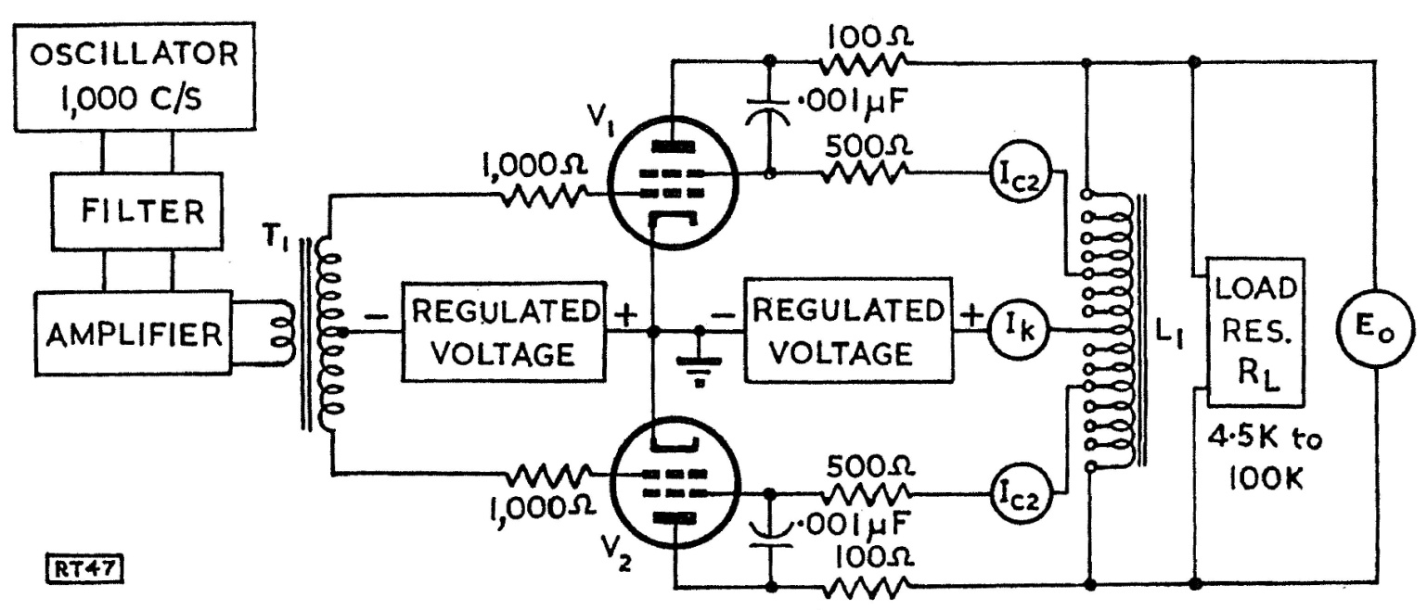
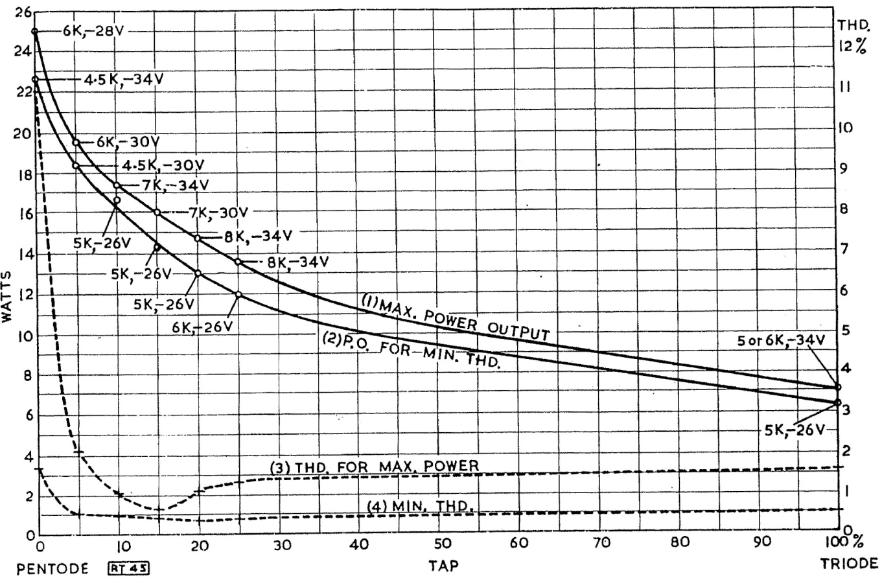
Circuit used for deriving test results
Published in Radiotronics Volume 20.
Output power and THD as function
of $x_{impedance−\%}$ .
Lowest THD at
$x_{impedance−\%}≈$ 15 %
or
$x_{turns−\%}=39 \%$ $≈40 \%$
$$x_{impedance−\%}$$

Slide 28
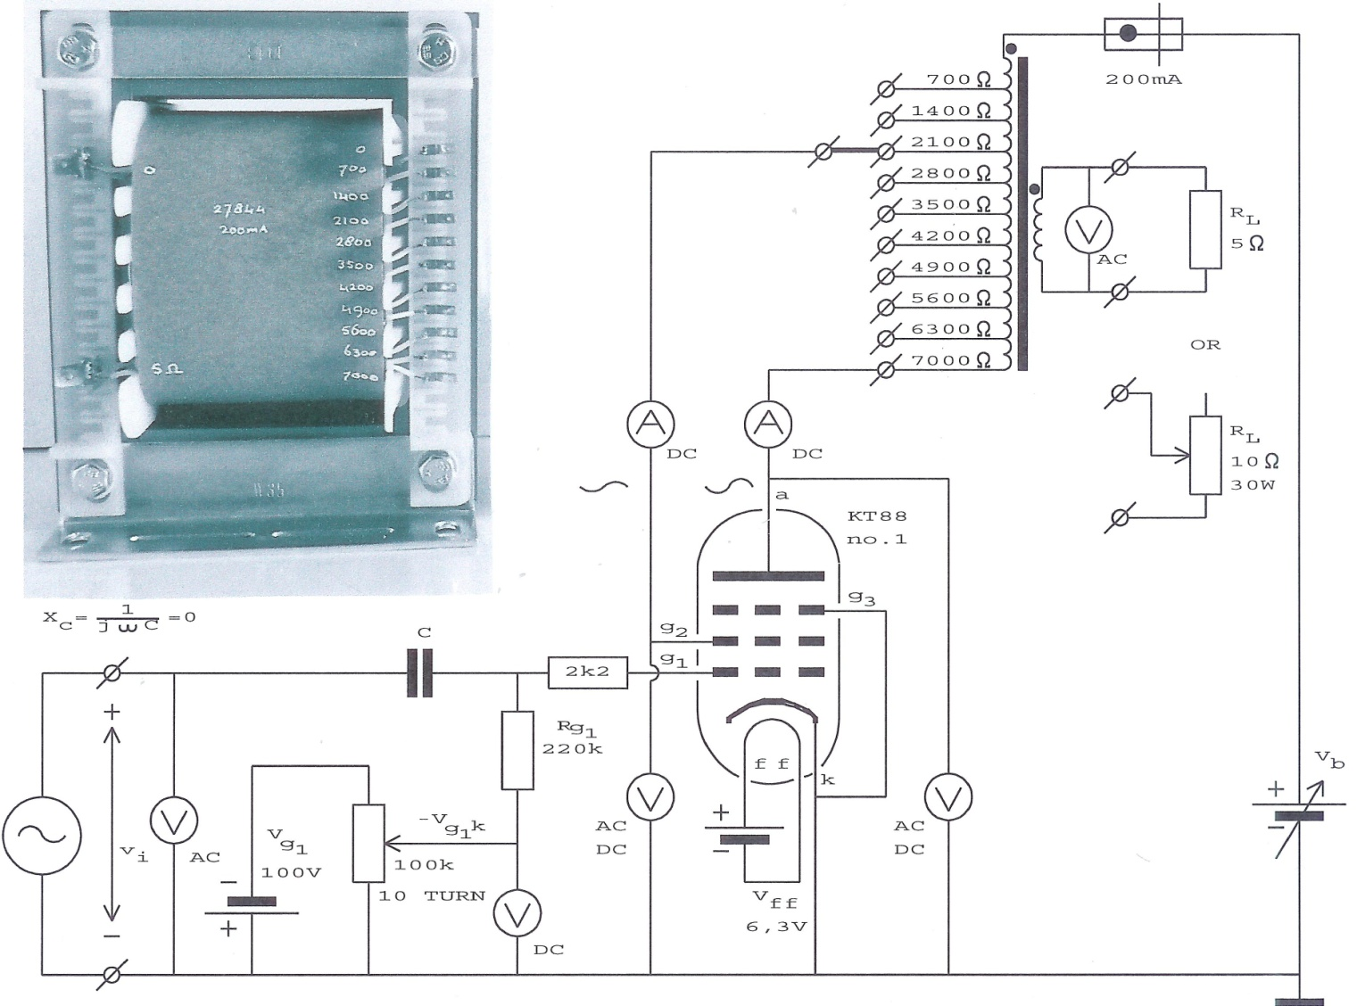
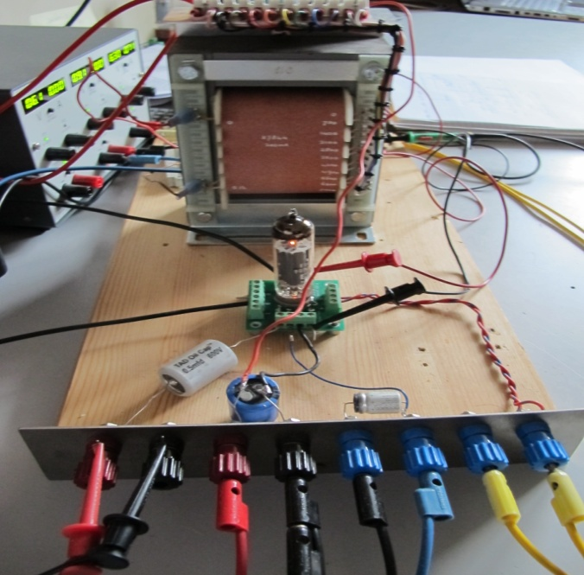
8. More recent THD-measurement results

Slide 29
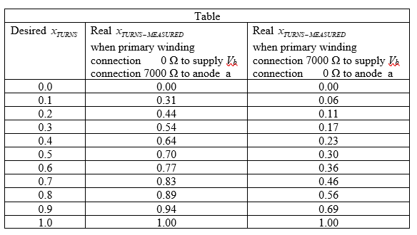

Slide 33
9. Some interim conclusions
AC-method : most straight line in $I_{a}=f\left(V_{ak}\right)$ at $x_{turns}≈25 \%$
DC-method : most straight line in $I_{a}=f\left(V_{ak}\right)$ at $x_{turns}≈25 \%$
Measurements from the past : lowest THD at $x_{turns}≈40 \%$
More recent measurements : lowest THD at $x_{turns}≈45 \%$
So the most straight line in $I_{a}=f\left(V_{ak}\right)$ gives NOT the lowest THD.
Apparently there is another phenomenon that influences the THD.
Before we focus on that phenomenon we must understand the difference
between the static transconductance and the dynamic transconductance.

Slide 34
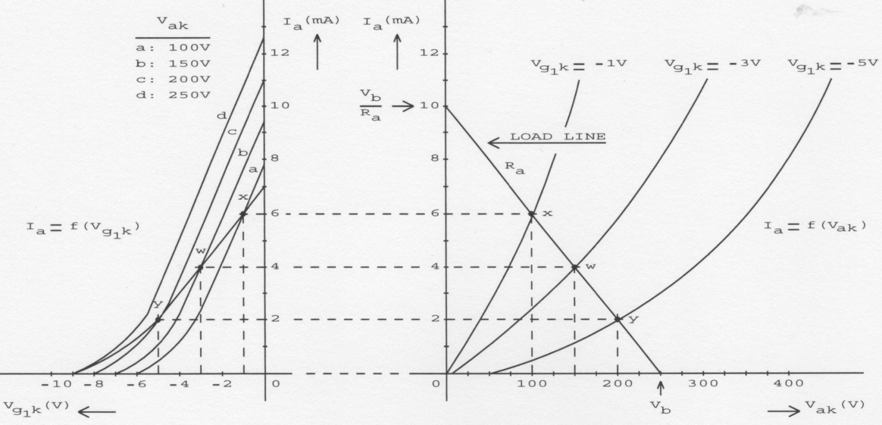
10. An intermezzo: static transconductance versus dynamic transconductance
Static transconductances a, b, c and d in I_{a} = f (V_{g1k}) for a triode.
Dynamic transconductance (line x-w-y) in I_{a} = f (V_{g1k}) for a triode due to load line.

Slide 35
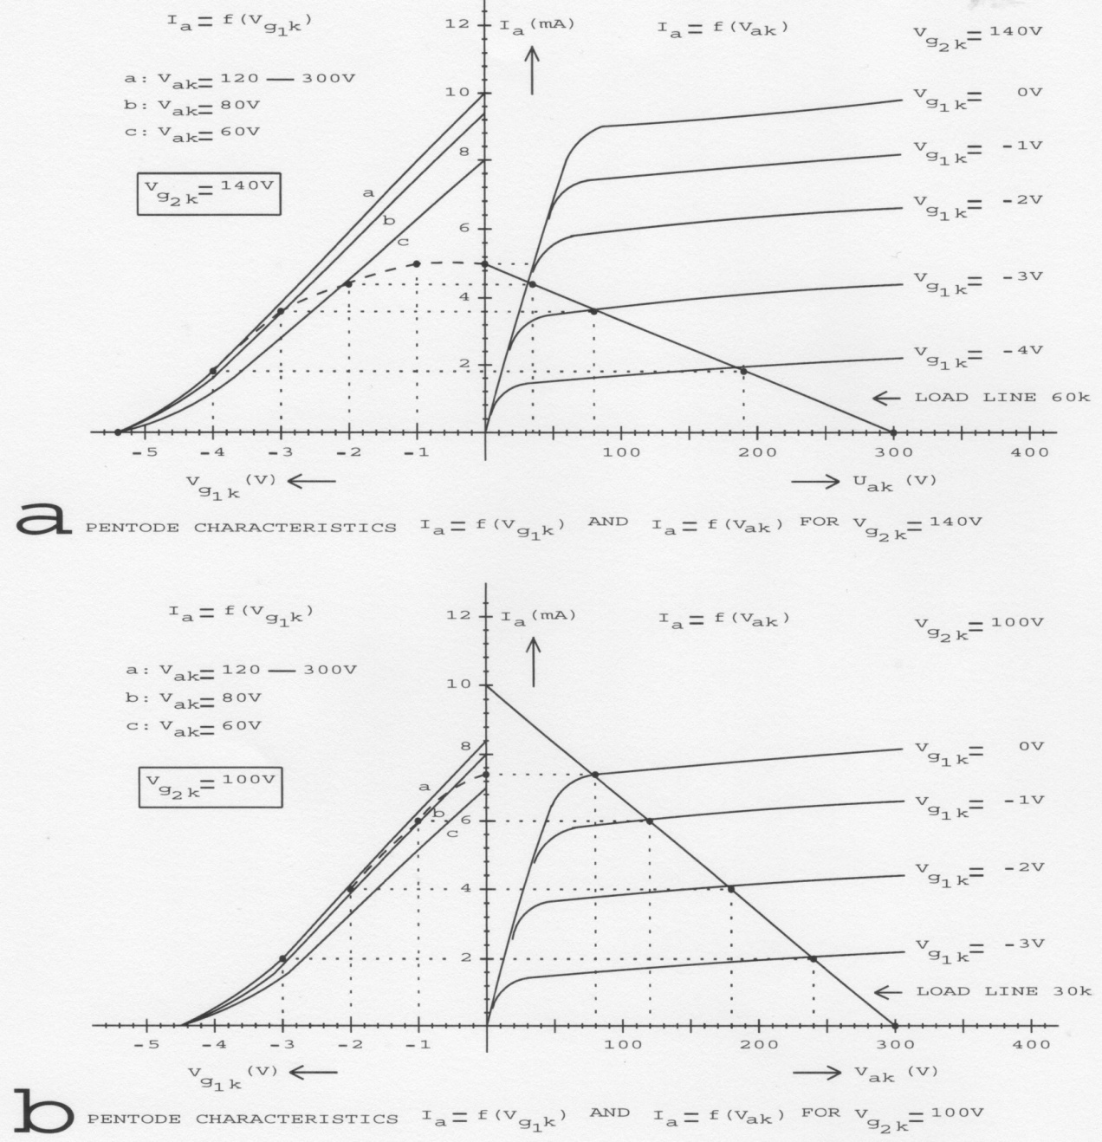
Static transconductances a, b and c in I_{a} = f (V_{g1k}) for a pentode.
Dynamic transconductance (dashed line) in I_{a} = f (V_{g1k}) for a pentode due to a load line.

Slide 36
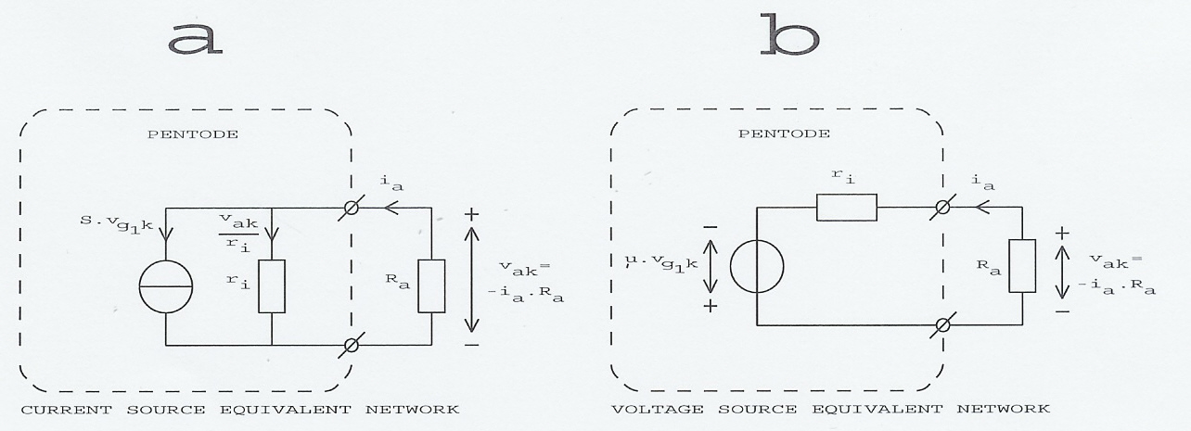
Voltage source and current source equivalent circuits of a triode with anode resistor.
Current source and voltage source equivalent circuits of a pentode with anode resistor with neglected i_{g2}.

Slide 37
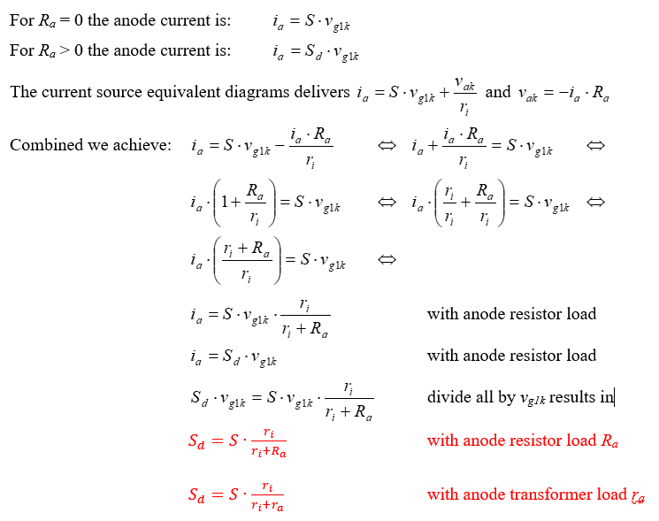

Slide 38
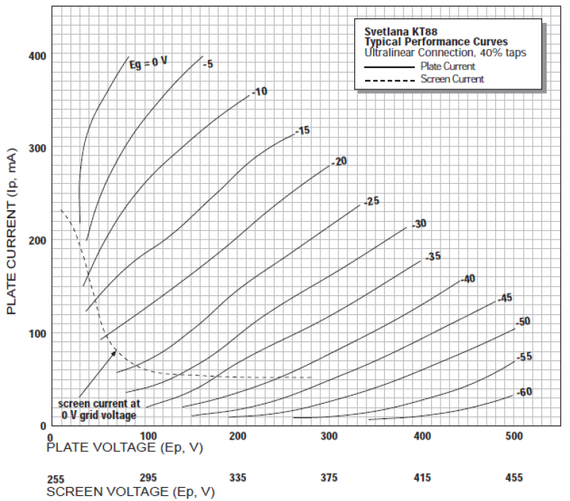
Focus not only on the anode but also on the transconductance characteristic
Tube manufactures give
hardly transconducance
characteristics for triodes and never for penthodes !

Slide 39
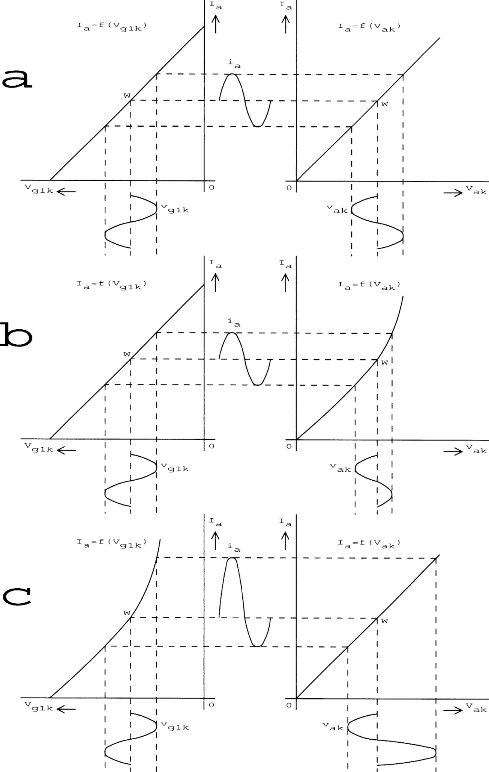
Ideal transconductance characteristic and ideal
anode characteristic gives NO harmonic distortions.
Ideal transconductance characteristic and NOT ideal
anode characteristic gives harmonic distortions.
NOT ideal transconductance characteristic and ideal
anode characteristic gives harmonic distortions.

Slide 40
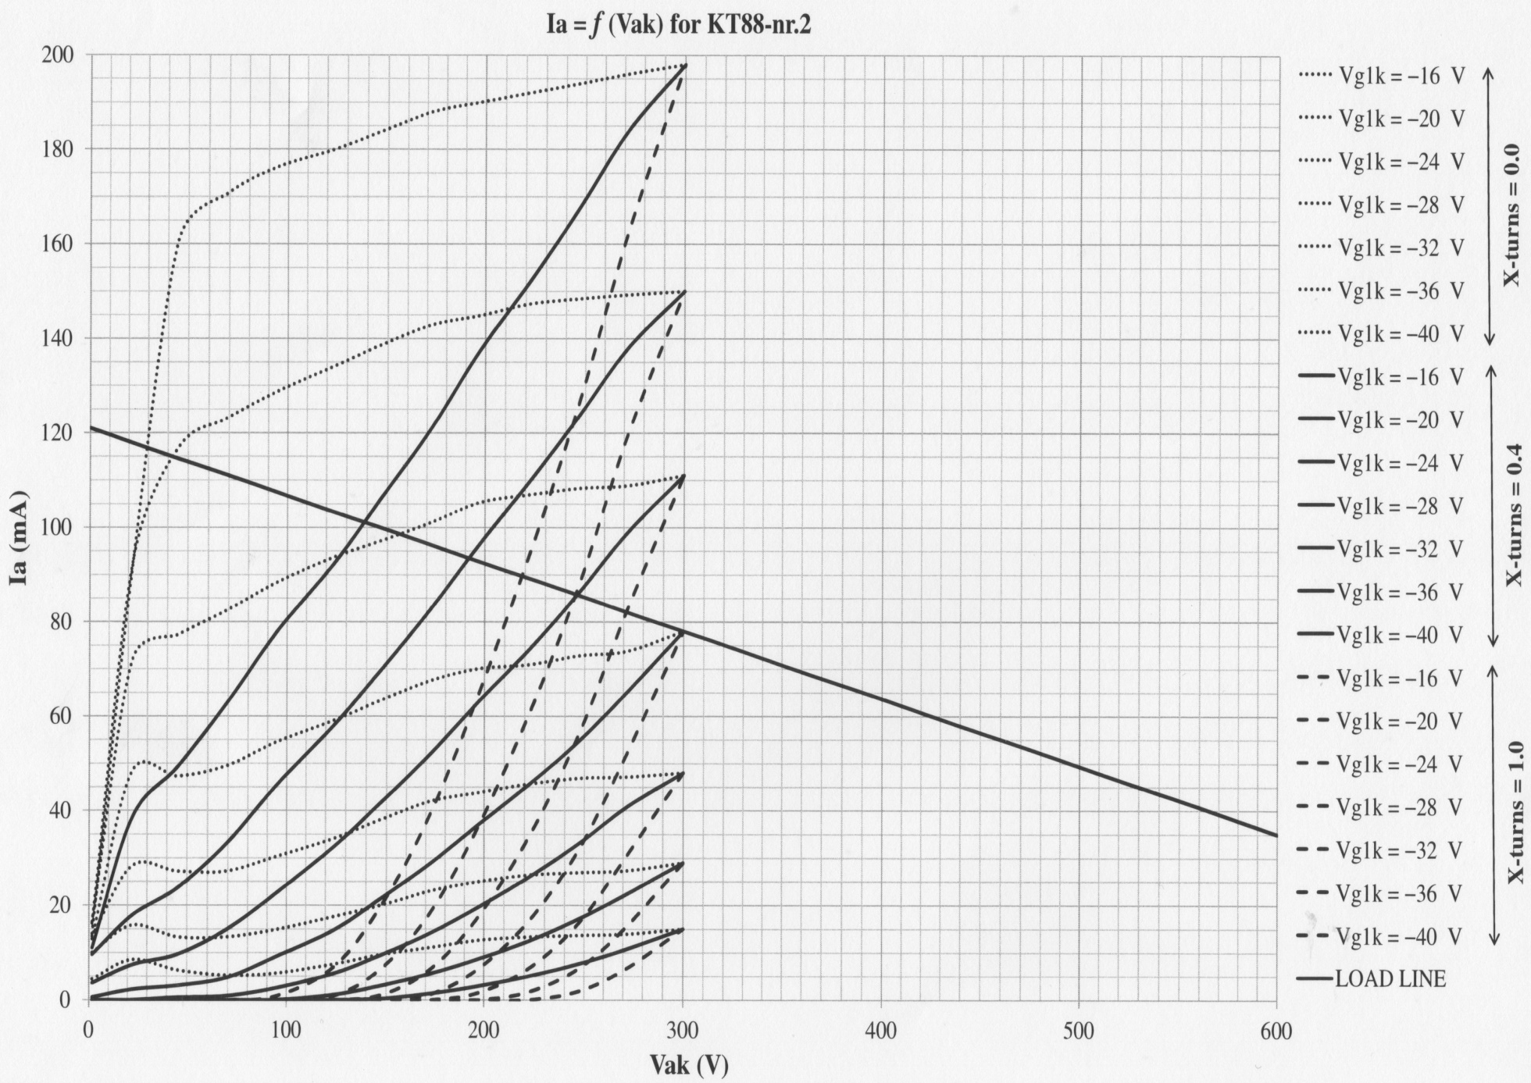

Slide 41
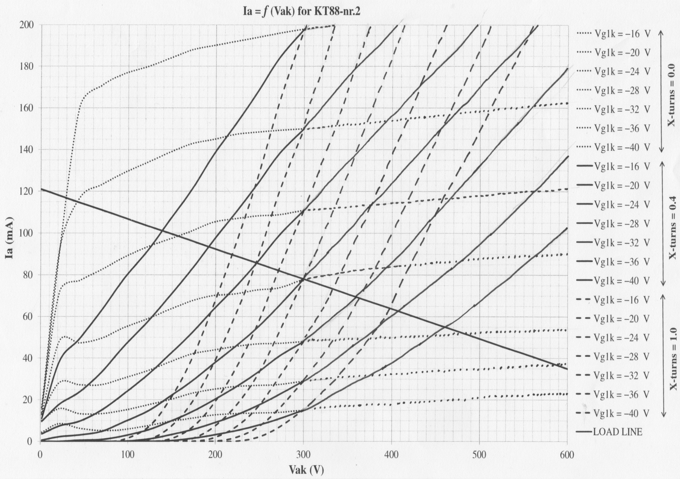

Slide 42
12. The forgotten anode dynamic transconductances
I have measured at EL84, EL34 and KT88, the anode characteristic $I_{a}=f\left(V_{ak}\right)$
for $x_{turns−measured}$ is respectively 0.00 ; 0.06 ; 0.11 ; 0.17 ; 0.23 ; 0.30 ; 0.36 ; 0.46 ; 0.56 ; 0.69 ; 1.00 .
These numbers are copied from the right-side column of the tabel of sheet 29 and related to my exotic output transformer.
Then I constructed for EL84, EL34 and KT88, the dynamic transconductance characteristic $I_{a}=f\left(V_{g1k}\right)$
for $x_{turns−measured}$ is respectively 0.00 ; 0.06 ; 0.11 ; 0.17 ; 0.23 ; 0.30 ; 0.36 ; 0.46 ; 0.56 ; 0.69 ; 1.00 .
In the next sheets I will show the forgotten dynamic transconductances !!!
But first I show the way to these results via the anode characteristic and the load line of 7000Ω.

Slide 43
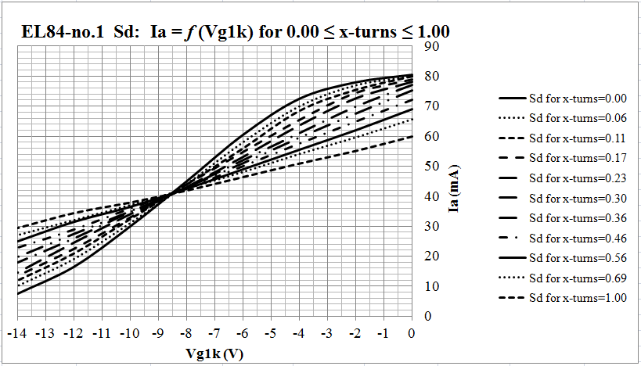

Slide 44
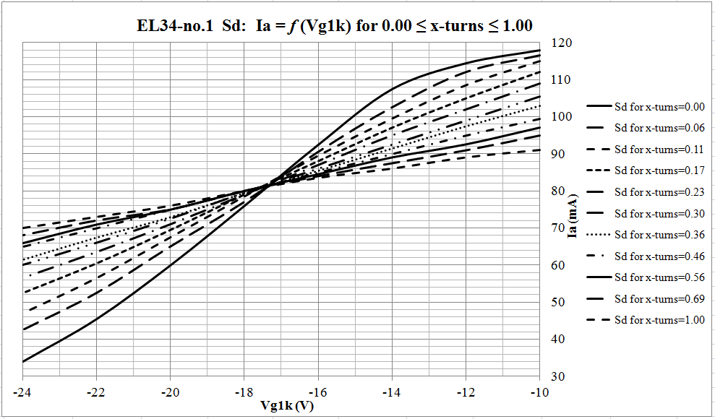

Slide 45
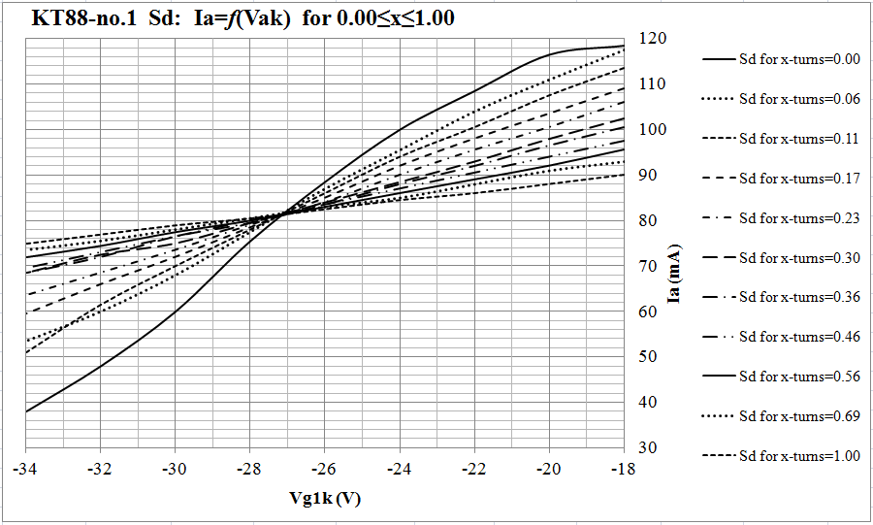

Slide 46
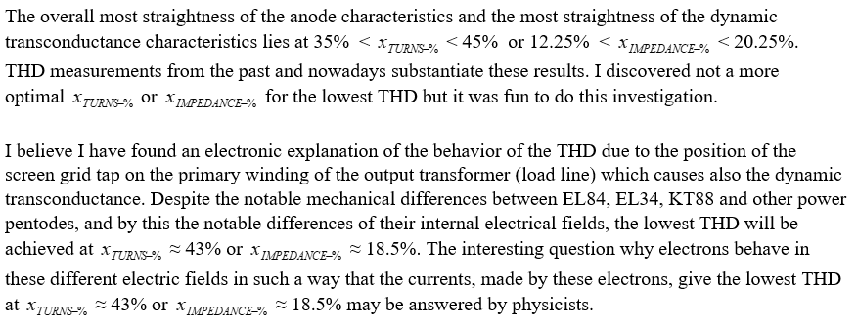
13. Final conclusion

Slide 47
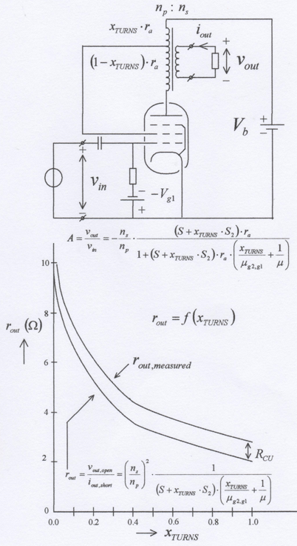
Order at www.boekenbestellen.nl .

